Slide 1
FUNCTIONS

Slide 2
In discrete mathematics, a function is a relation that associates each element from one set called the (domain) to exactly one element in another set called the (codomain).
Note: neque digni and in aliquet nisl et a umis varius.

Slide 3
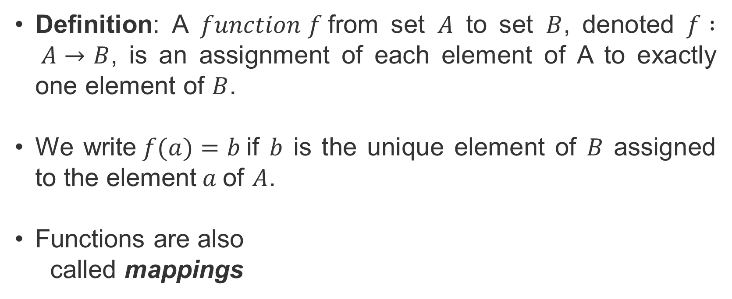
Definition: A $function f$from set $A$ to set $B$, denoted $f : A→B$, is an assignment of each element of A to exactly one element of $B$.
We write$f(a)=b$if $b$ is the unique element of $B$ assigned to the element$a$of $A$.
Functions are also
called mappings
Note: neque digni and in aliquet nisl et a umis varius.

Slide 4

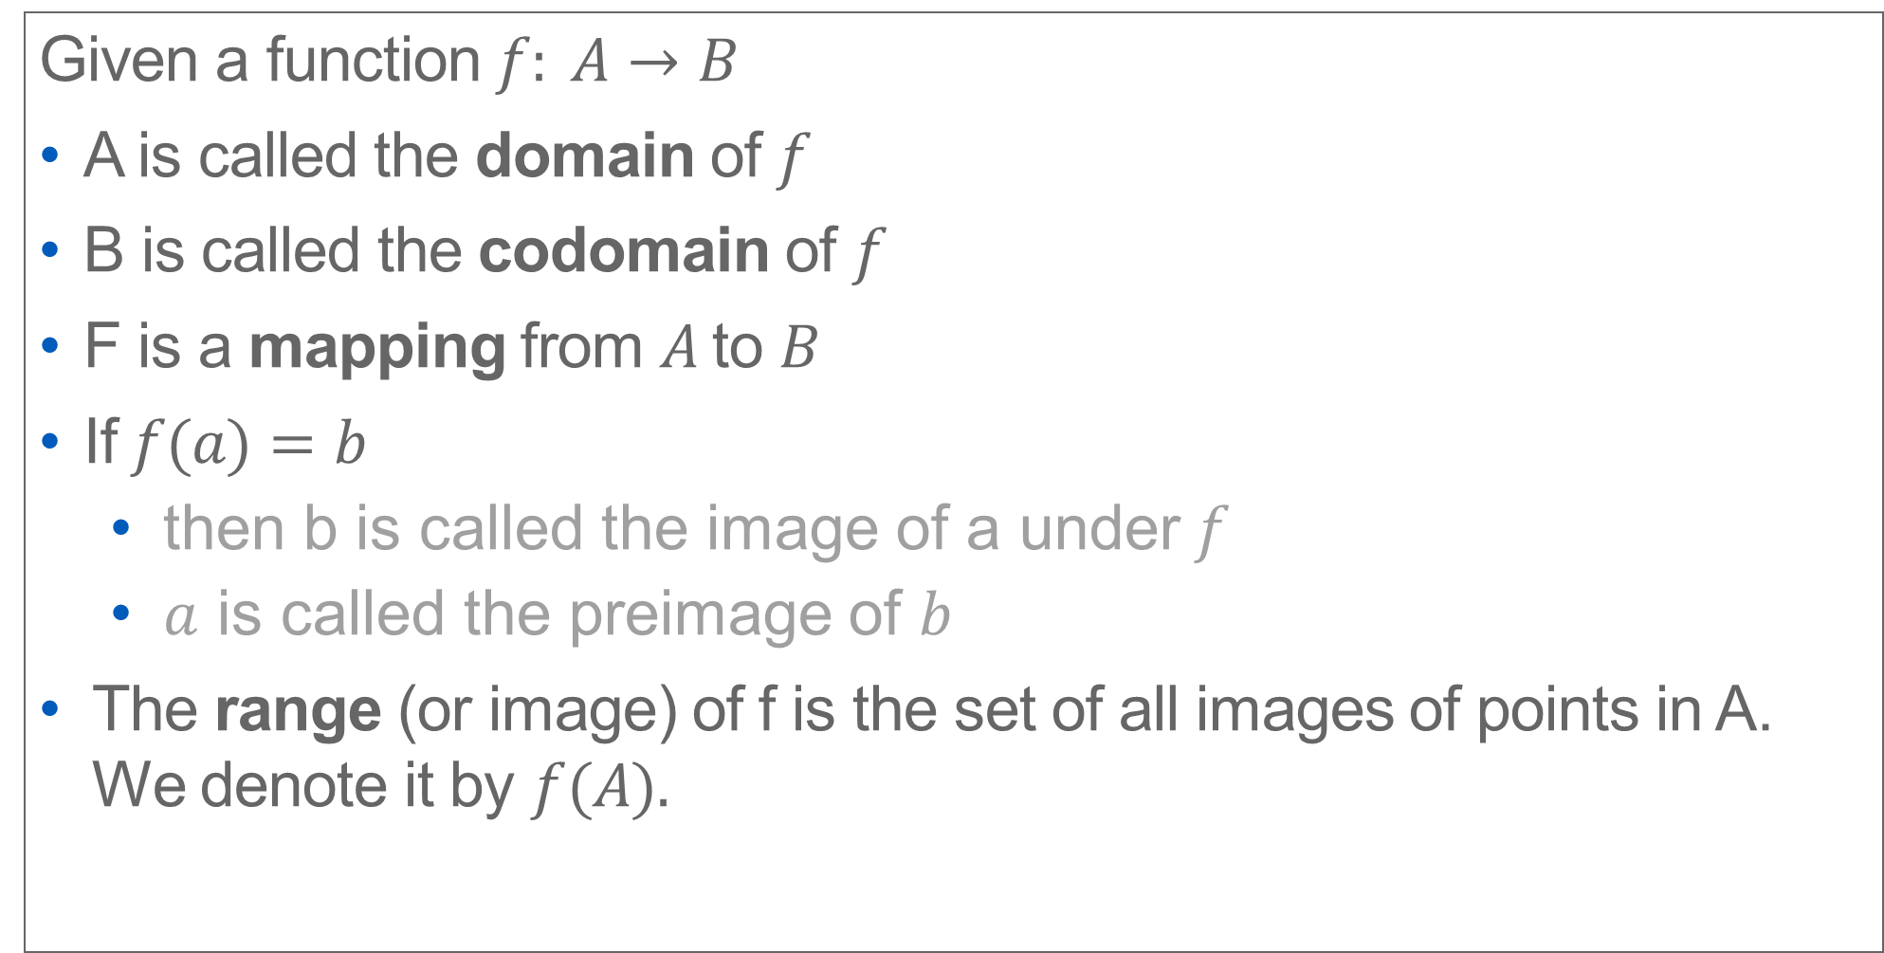



Given a function $f: A→B$
A is called the domain of $f$
B is called the codomain of $f$
F is a mapping from $A$to $B$
If$f(a)=b$
then b is called the image of a under$f$
$a$ is called the preimage of $b$
The range (or image) of f is the set of all images of points in A. We denote it by $f(A).$
$$f$$
a
$$b=f(a)$$
A
B
$$f$$

Slide 5

Example
The domain of$f$is $A$
The codomain of$f$ is $B$
The image of$b$is $y$
$f(b)=y$
The preimage of$y$is $b$
The preimage of $z$is $(a,c,d)$
The range/image of $A$ is $(y,z)$
$f(A)=\{y,z\}$
A B
a
x
b
y
c
z
d

Slide 6
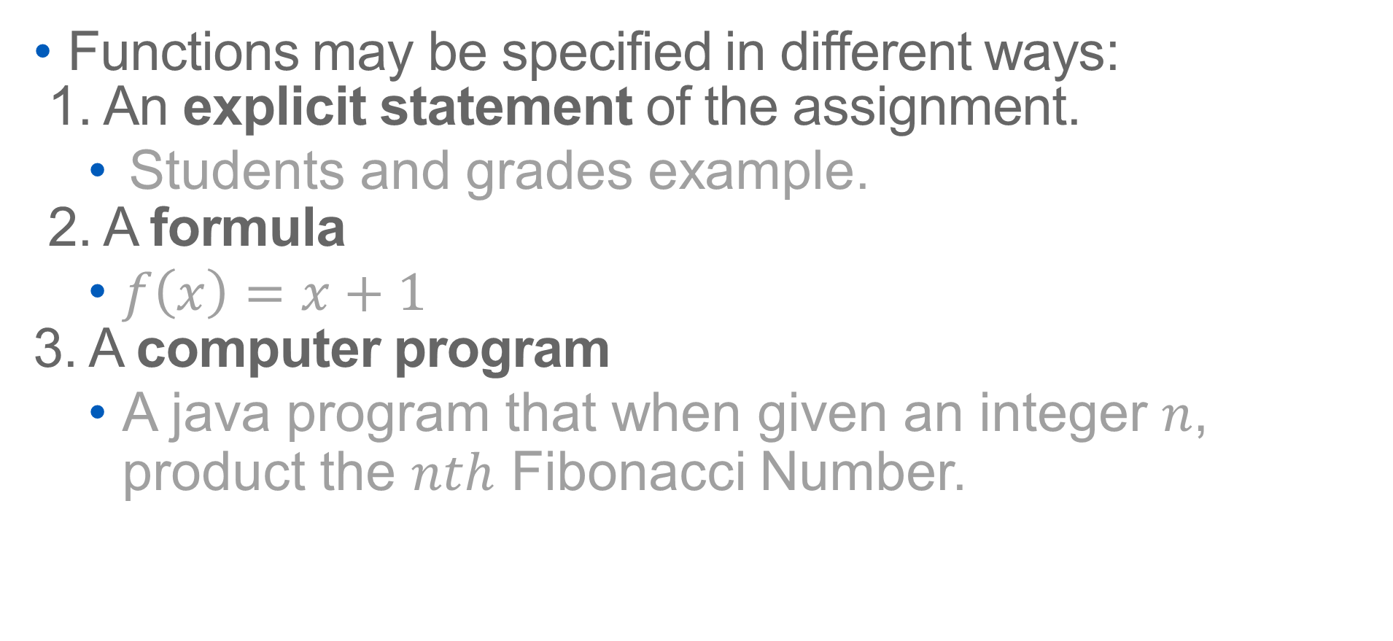
Representing functions
Functions may be specified in different ways:
1. An explicit statement of the assignment.
Students and grades example.
2. A formula
$f\left(x\right)=x+1$
3. A computer program
A java program that when given an integer $n$, product the $nth$ Fibonacci Number.

Slide 7
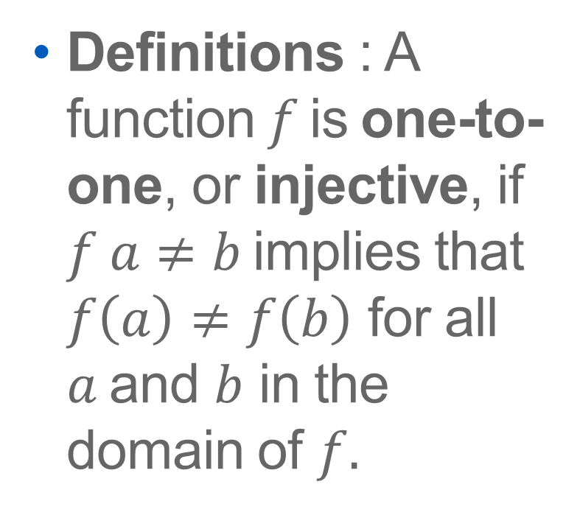
Injections
Definitions : A function$f$is one-to-one, or injective, if $f a≠b$implies that $f\left(a\right)≠f\left(b\right)$ for all $a$and $b$ in the domain of $f.$
A B
a
x
b
v
c
y
d
z
w

Slide 8
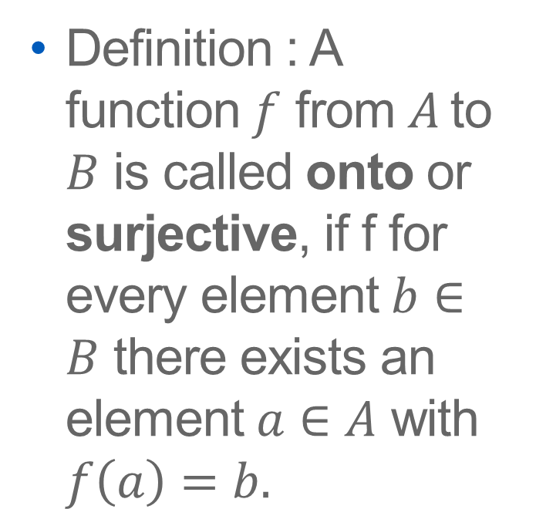
Surjections
Definition : A function $f$ from $A$to $B$ is called onto or surjective, if f for every element $b∈B$ there exists an element $a∈A$ with $f\left(a\right)=b.$
A B
a
x
b
y
c
z
d

Slide 9
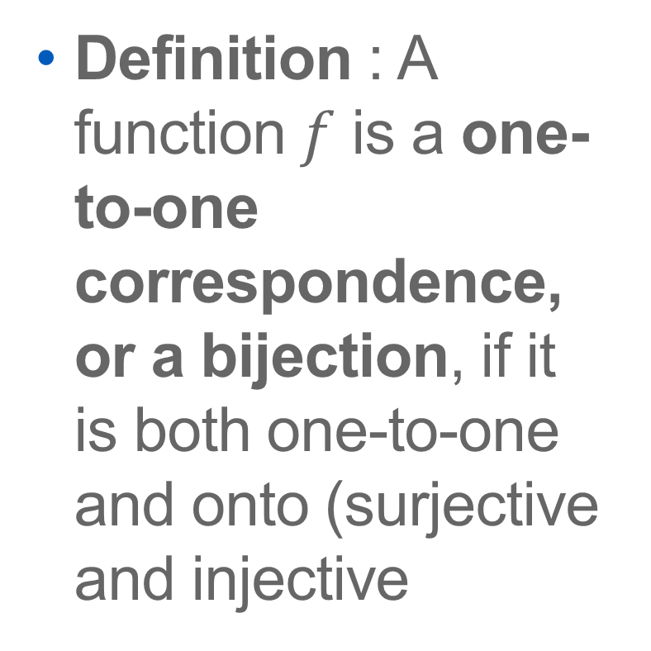
Bijections
Definition : A function $f$ is a one-to-one correspondence, or a bijection, if it is both one-to-one and onto (surjective and injective
A B
a
x
b
y
c
z
d
w

Slide 10
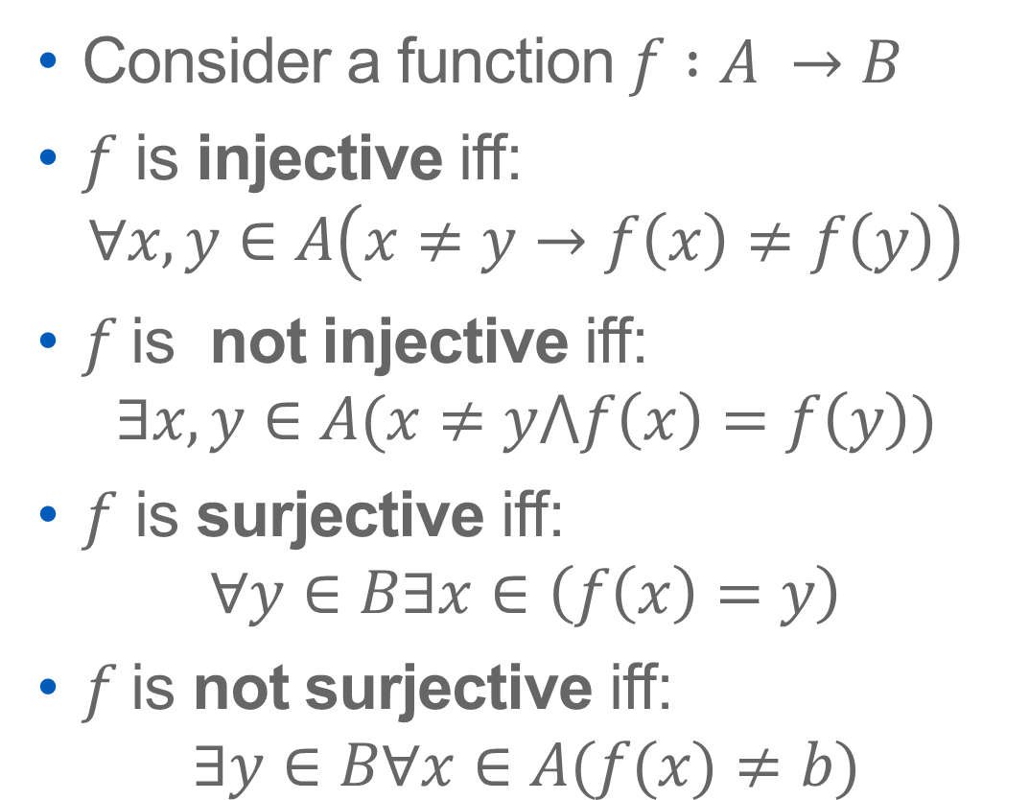
Showing that f is/is not injective or surjective
Consider a function $f :A →B$
$f$ is injective iff:
$$∀x,y∈A\left(x≠y→f\left(x\right)≠f\left(y\right)\right)$$
$f$is not injective iff:
$$∃x,y∈A(x≠y⋀f\left(x\right)=f\left(y\right))$$
$f$ is surjective iff:
$$∀y∈B∃x∈\left(f\left(x\right)=y\right)$$
$f$is not surjective iff:
$$∃y∈B∀x∈A(f(x)≠b)$$

Slide 11





Inverse Functions
Definition : Let $f$ be a bidirection from $A to B$. Then the inverse of f, denoted $f^{−1},$is the function from $B$ to $A$ defined as
$$f^{−1}\left(y\right)=x iff f\left(x\right)−y$$
$$f^{−1}(b)$$
$$a=f^{−1}(b)$$
$$b=f(a)$$
A
B
No inverse exists unless $f$ is a bijection

Slide 12
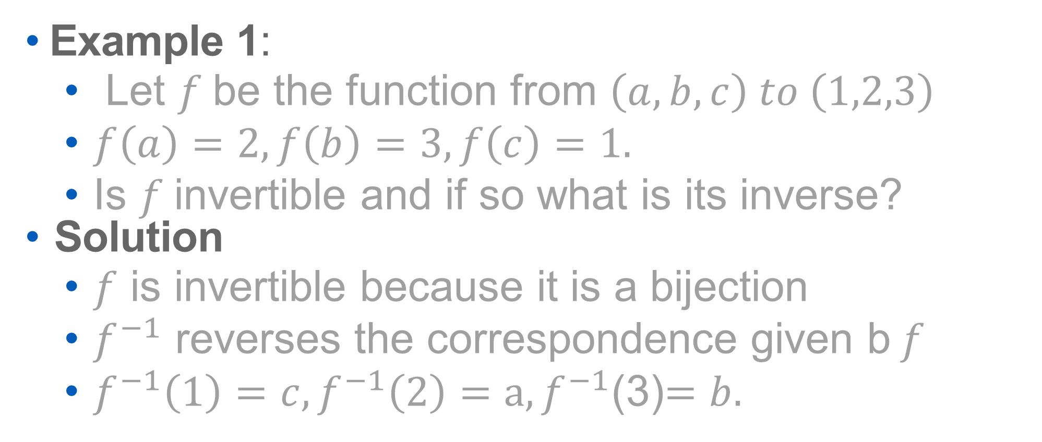
Example 1:
Let $f$be the function from $\left(a,b,c\right) to \left(1,2,3\right)$
$f\left(a\right)=2, f\left(b\right)=3,f\left(c\right)=1.$
Is $f$invertible and if so what is its inverse?
Solution
$f$ is invertible because it is a bijection
$f^{−1}$ reverses the correspondence given b$f$
$f^{−1}\left(1\right)=c, f^{−1}\left(2\right)=a, f^{−1}$(3)$=b.$

Slide 13
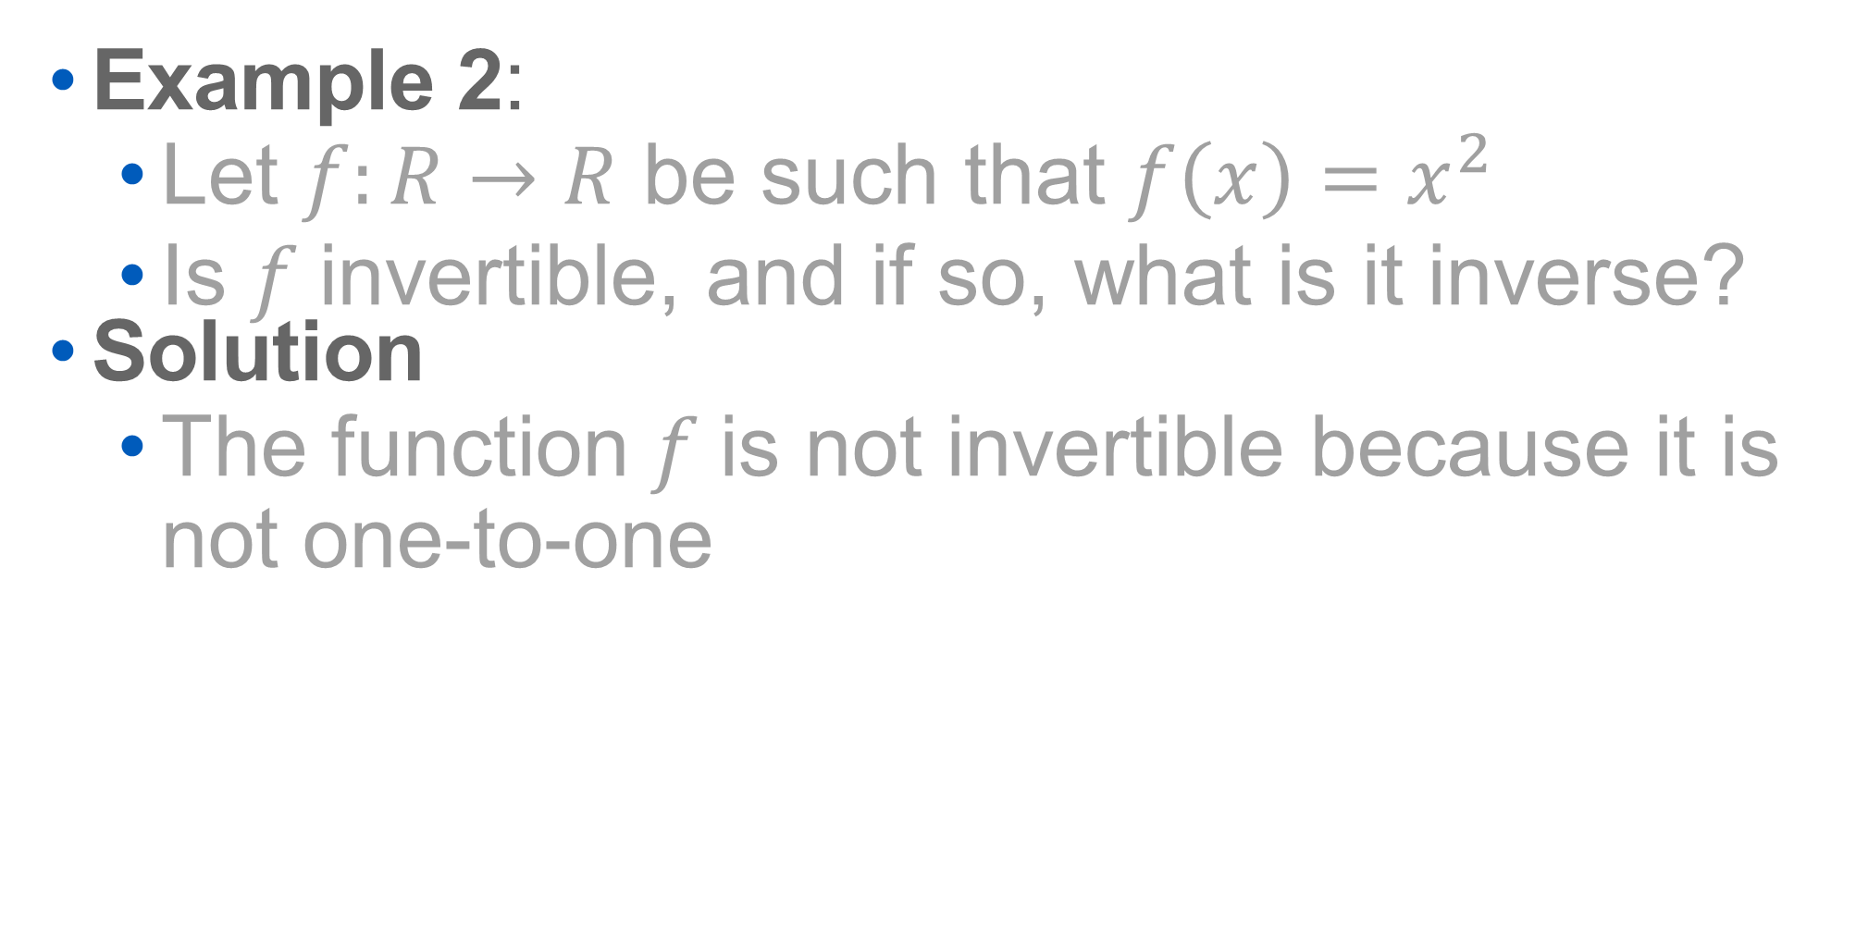
Example 2:
Let $f:R→R$ be such that $f\left(x\right)=x^{2}$
Is $f$invertible, and if so, what is it inverse?
Solution
The function $f$is not invertible because it is not one-to-one

Slide 14
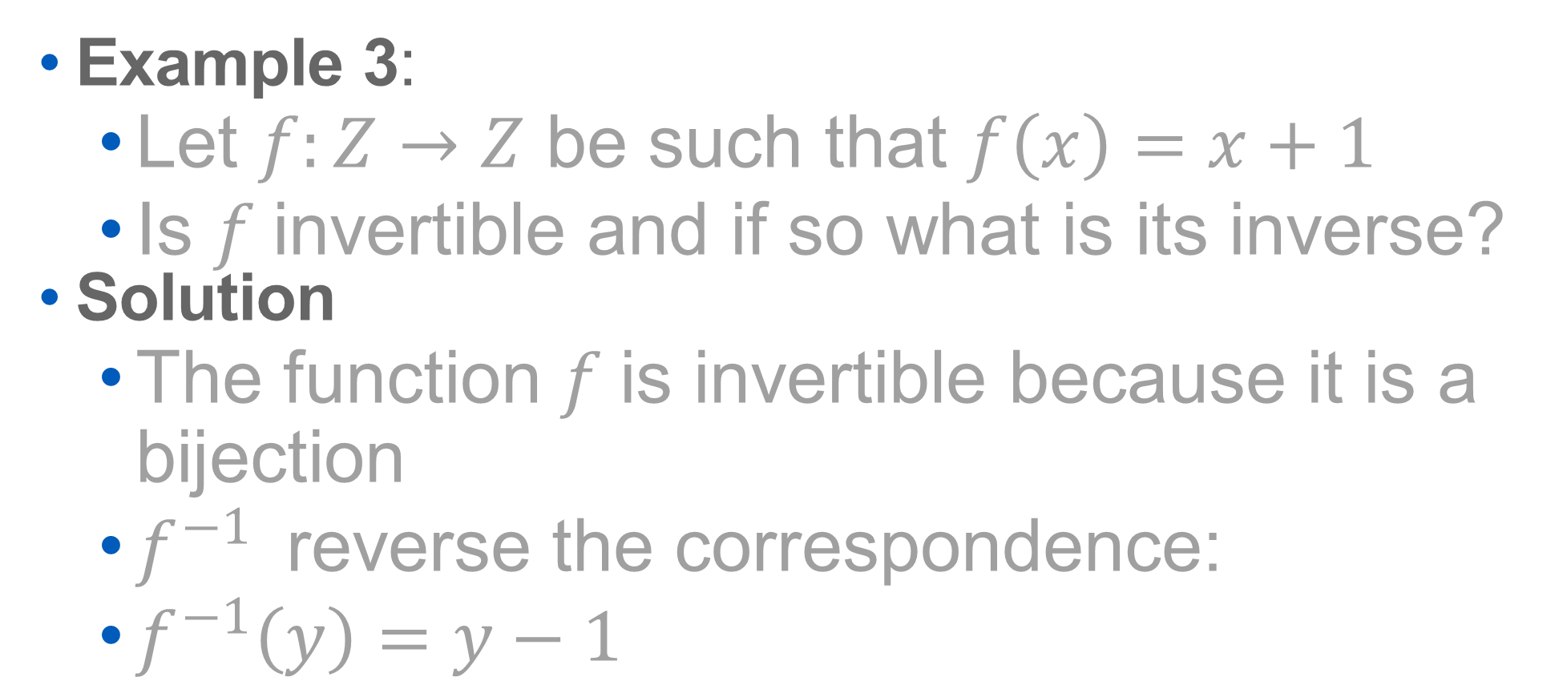
Example 3:
Let $f:Z→Z$ be such that $f\left(x\right)=x+1$
Is $f$invertible and if so what is its inverse?
Solution
The function $f$is invertible because it is a bijection
$f^{−1}$reverse the correspondence:
$f^{−1}\left(y\right)=y−1$

Slide 15
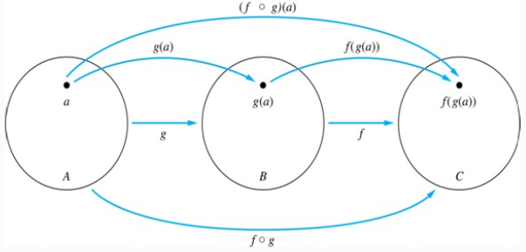
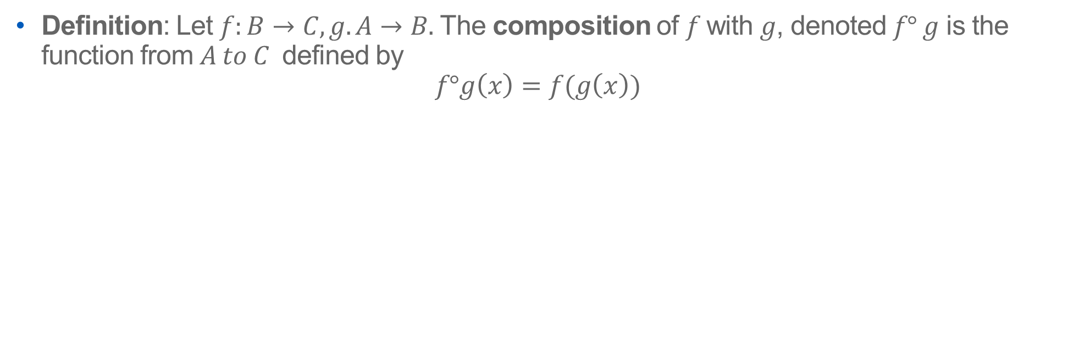
Composition
Definition: Let $f:B→C, g. A→B.$ The composition of $f$with $g$, denoted $f° g$ is the function from $A to C$ defined by
$$f°g\left(x\right)=f(g\left(x\right))$$

Slide 16








g f $f°g$
A B C A C
a
h
v
b
i
w
c
j
x
d
y

Slide 17
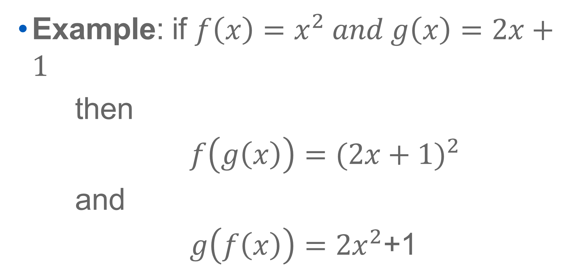
Example: if $f\left(x\right)=x^{2} and g\left(x\right)=2x+1$
then
$f\left(g\left(x\right)\right)={(2x+1)}^{2}$
and
$g\left(f\left(x\right)\right)={2x}^{2}$+1

Slide 18
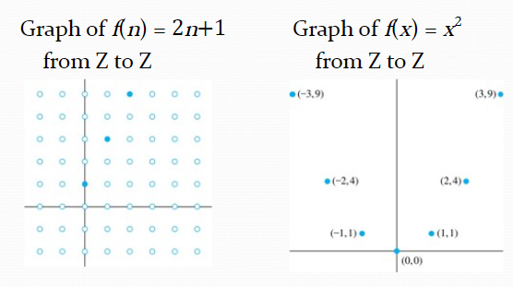
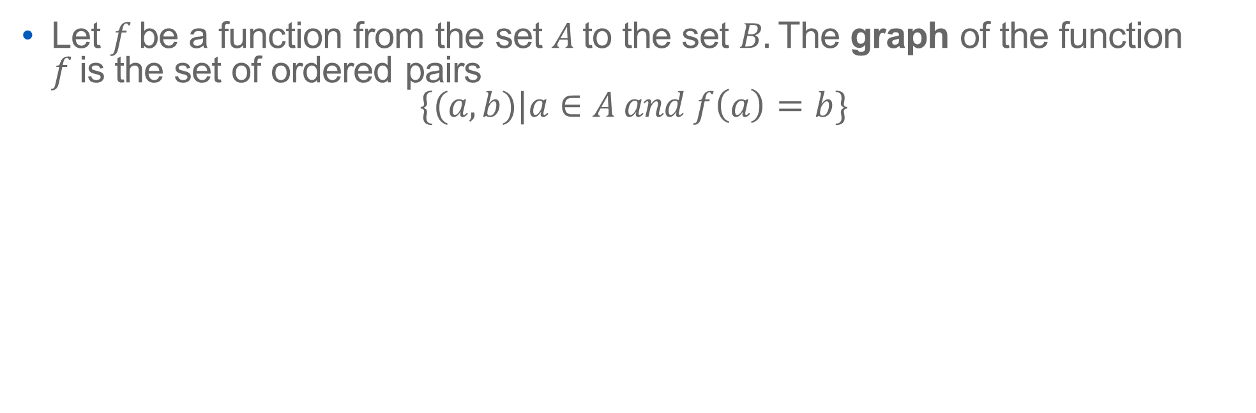
Graphs of Functions
Let $f$be a function from the set $A$to the set $B.$The graph of the function $f$is the set of ordered pairs
$$\{(a,b)|a∈A and f\left(a\right)=b\}$$

Slide 19
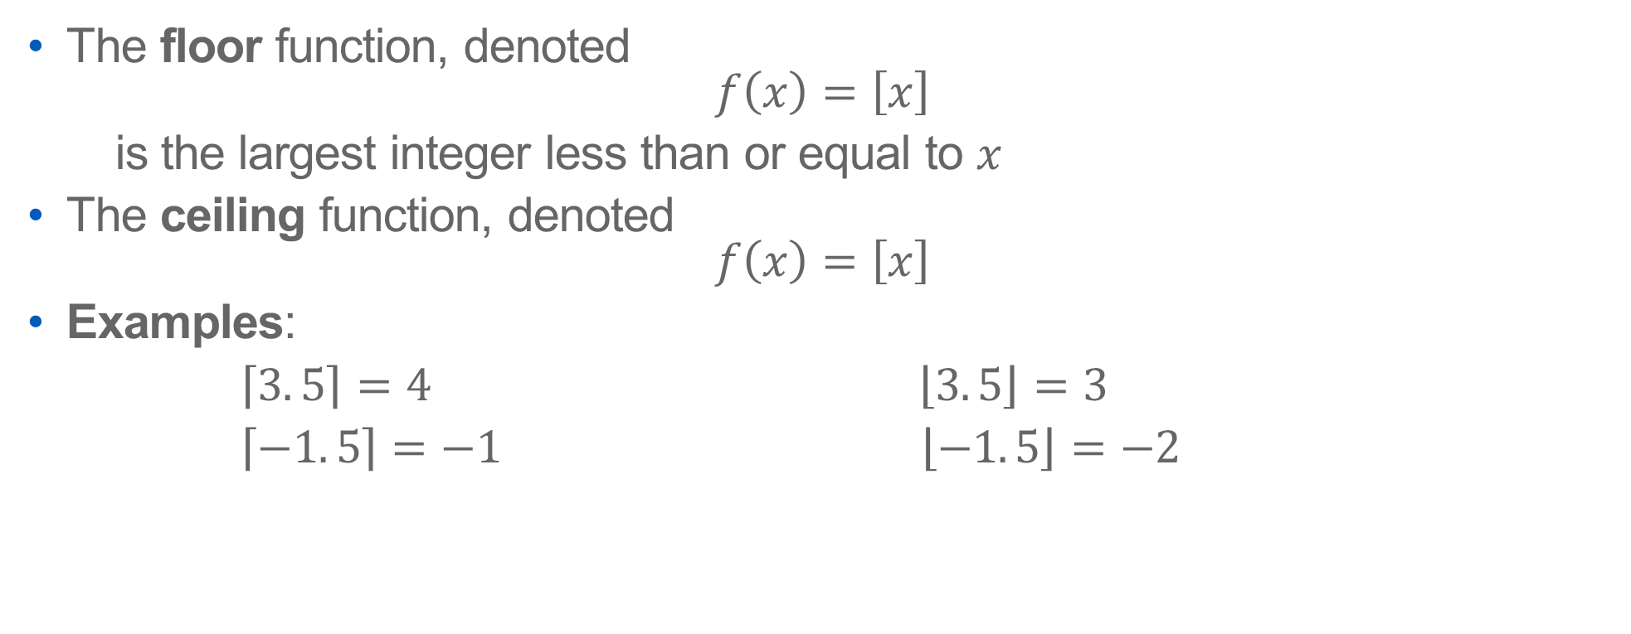
Some Important Functions
The floor function, denoted
$$f\left(x\right)=\left[x\right]$$
is the largest integer less than or equal to $x$
The ceiling function, denoted
$$f\left(x\right)=\left[x\right]$$
Examples:
$\left\lceil 3.\left.5\right\rceil \right.=4 \left\lfloor 3.\left.5\right\rfloor \right.=3$
$\left\lceil −1.\left.5\right\rceil \right.=−1 \left\lfloor −1.\left.5\right\rfloor \right.=−2$

Slide 20
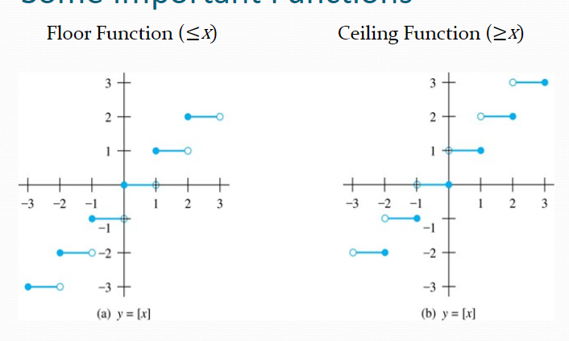

Slide 21
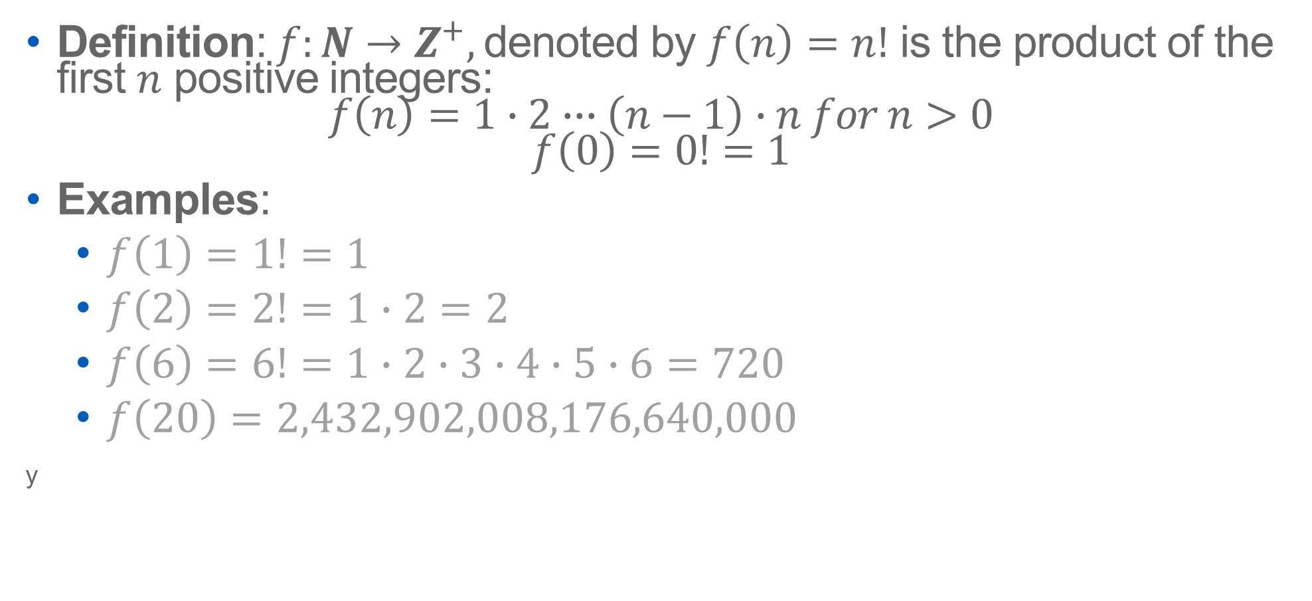
Factorial Function
Definition: $f:N→Z^{+},$denoted by $f\left(n\right)=n!$ is the product of the first $n$ positive integers:
$$f\left(n\right)=1∙2∙∙∙\left(n−1\right)∙n for n>0$$
$$f\left(0\right)=0!=1$$
Examples:
$f\left(1\right)=1!=1$
$f\left(2\right)=2!=1∙2=2$
$f\left(6\right)=6!=1∙2∙3∙4∙5∙6=720$
$f\left(20\right)=2,432,902,008,176,640,000$
y

Slide 22



THANK YOU!

